Slide 1
CS5560 Knowledge Discovery and Management Semantic Web
Ian Horrocks, Description Logic Based Ontology Languages

Slide 2
The Vision
500 million users
more than 3 billion pages
WWW
URI, HTML, HTTP
Source: ICWS 2005 Tutorial – Semantic Web Services by M. Stollberg and A. Haller

Slide 3
The Vision
Serious Problems in
information finding,
information extracting,
information representing,
information interpreting and
and information maintaining.
WWW
URI, HTML, HTTP
Semantic Web
RDF, RDF(S), OWL
Source: ICWS 2005 Tutorial – Semantic Web Services by M. Stollberg and A. Haller

Slide 4
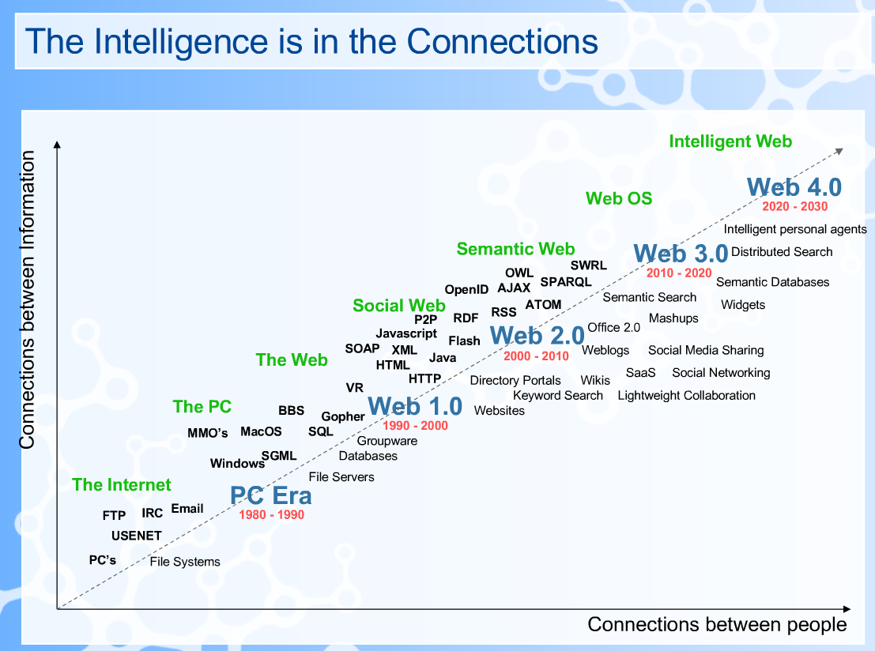
My Experiences Attempting To Scale The Semantic Web
John Clarke Mills

Slide 5
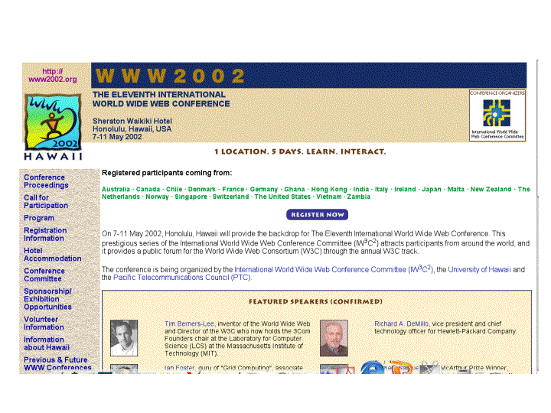
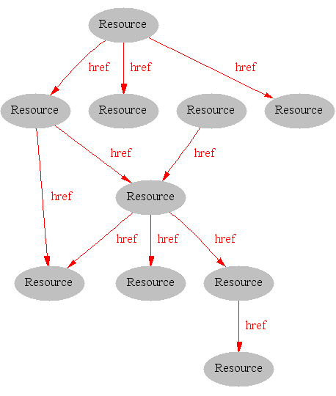
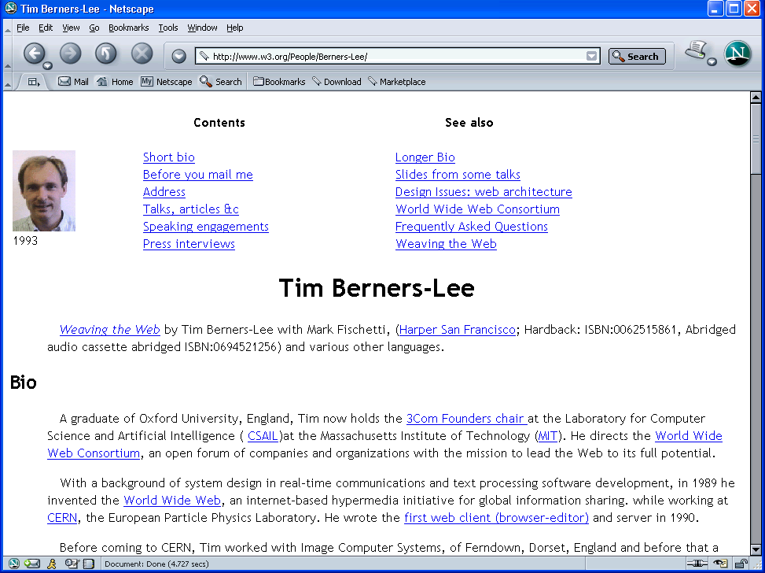
Where we are Today: the Syntactic Web
Video : Web 2.0 Machine is Us/ing US
[Hendler & Miller 02]
Video source: http://youtube.com/watch?v=NLlGopyXT_g

Slide 6
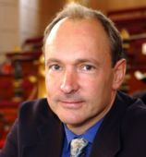
The Semantic Web
"The Semantic Web is an extension of the current web in which information is given well-defined meaning, better enabling computers and people to work in cooperation.“ – Berners-Lee, Hendler & Lassila, Scientific American, 2001
Video: Tim Berners-Lee on Semantic Web
Image source: http://en.wikipedia.org/wiki/Image:W3c_semantic_web_stack.jpg
Video source:
http://www.youtube.com/watch?v=HeUrEh-nqtU&feature=related
http://www.youtube.com/watch?v=Jev2Um-4_TQ

Slide 7
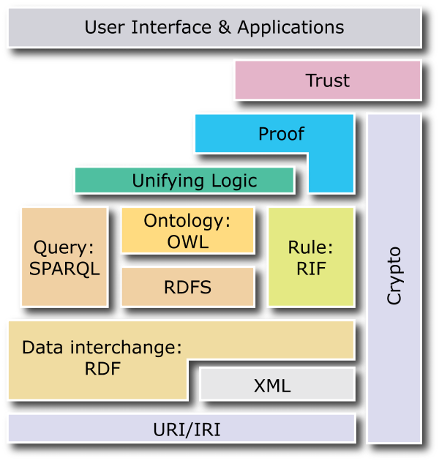
The Semantic Web Layer Cake
source: http://www.w3.org/2007/03/layerCake.png
Notes:
Internationalized Resource Identifiers (IRIs)

Slide 8
Ontology Definition
In computer science and information science:
an ontology encompasses a representation, formal naming and definition of the categories, properties and relations between the concepts, data and entities that substantiate one, many or all domains of discourse.
More simply, an ontology is a way of showing the properties of a subject area and how they are related, by defining a set of concepts and categories that represent the subject.
Ontologies are a formal way to describe taxonomies and classification networks, essentially defining the structure of knowledge for various domains: the nouns representing classes of objects and the verbs representing relations between the objects.
Source:https://en.wikipedia.org/wiki/Ontology_(information_science)

Slide 9
Ontology Definition
formal, explicit specification of a shared conceptualization
unambiguous terminology definitions
conceptual model of a domain (ontological theory)
[Gruber, 1993]
machine-readability with computational semantics
commonly accepted understanding
Gruber, T. R. (1993). Toward principles for the design of ontologies used for
knowledge sharing. International Workshop on Formal Ontology.

Slide 10
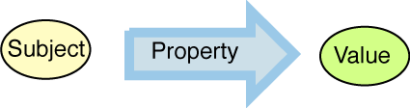
The Semantic Web is simple
Each URI denotes a concept
URIs are connected by triples
Machines read data as directed RDF graph
Don't say "color" say <http://example.com/2002/std6#col>
<http://...std6#apple>
<http://..../std6#color>
<http://.../std6#red>
Apple
hasColor
Red
RDF (Resource Description Framework)
Source: Tim Berners-Lee, Putting the Web back into Semantic Web, ISWC2005 Keynote

Slide 11
Example: RDF Graph
Animal Ontology
Person isA Animal
Man isA Person
Person has one Father
Figure source: Zhang, et al. Ontology Summarization Based on RDF Sentence Graph, WWW-2007

Slide 12
OWL
The Web Ontology Language (OWL) is a family of knowledge representation languages for authoring ontologies.

Slide 13
OWL Language
OWL is based on Description Logics knowledge representation formalism
OWL (DL) benefits from many years of DL research:
Well defined semantics
Formal properties well understood (complexity, decidability)
Known reasoning algorithms
Implemented systems (highly optimised)
Three species of OWL
OWL full is union of OWL syntax and RDF
OWL DL restricted to FOL fragment
OWL Lite is “easier to implement” subset of OWL DL
OWL DL based on SHIQ Description Logic

Slide 14
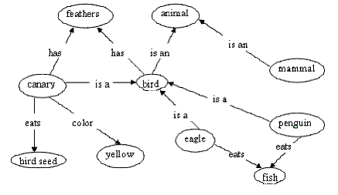
What Are Description Logics?
A family of logic based Knowledge Representation formalisms
Descendants of semantic networks and KL-ONE
Describe domain in terms of concepts (classes), roles (properties, relationships) and individuals

Slide 15
DL Basics
Concepts (unary predicates/formulae with one free variable)
E.g., Person, Doctor, HappyParent, (Doctor t Lawyer)
Roles (binary predicates/formulae with two free variables)
E.g., hasChild, loves, (hasBrother ± hasDaughter)
Individuals (constants)
E.g., John, Mary, Italy
Operators (for forming concepts and roles) restricted so that:
Satisfiability/subsumption is decidable and, if possible, of low complexity
No need for explicit use of variables
Features such as counting can be succinctly expressed

Slide 16
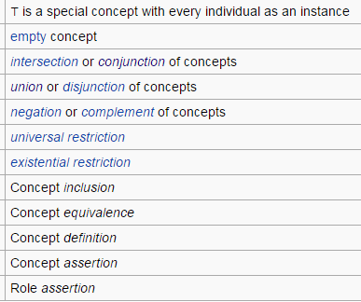
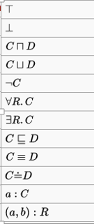
The DL Notation

Slide 17
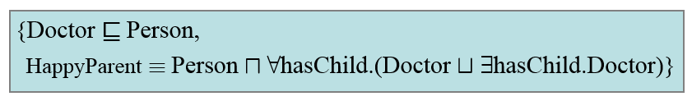
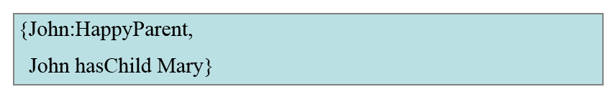
DL Knowledge Base
A TBox is a set of “schema” axioms (sentences)
E.g., Person all of whose children are either Doctors or have a child who is a Doctor
An ABox is a set of “data” axioms (ground facts)
A Knowledge Base (KB) is just a TBox plus an Abox

Slide 18
What is an Ontology?
A model of (some aspect of) the world
Introduces vocabulary relevant to domain
Specifies intended meaning of vocabulary
Typically formalized using a suitable logic
Closely related to schemas in the DB world
Instantiated by set of individuals and relations
Defines constraints on possible instantiations

Slide 19
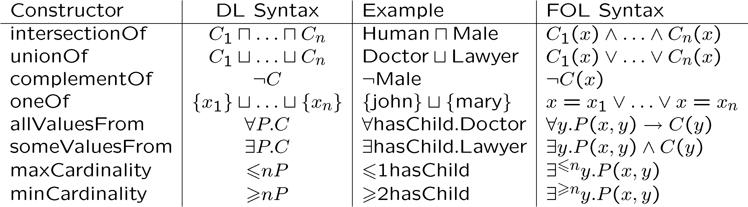
Class/Concept Constructors
for C a concept (class); P a role (property); x an individual name

Slide 20
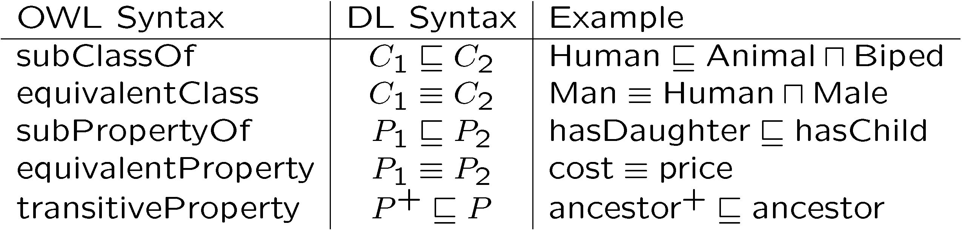
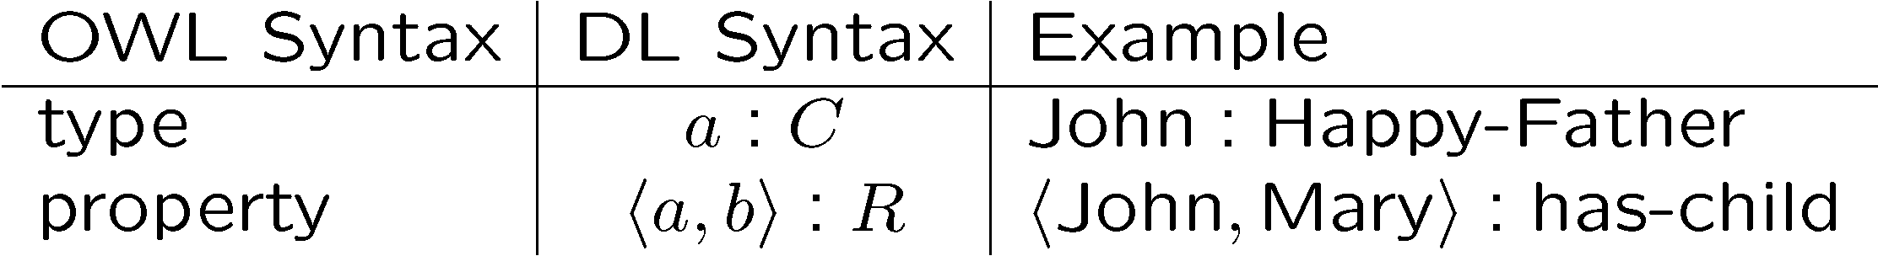
Ontology Axioms
An Ontology is usually considered to be a TBox
but an OWL ontology is a set of TBox and ABox axioms

Slide 21
Semantic Web Tools
Pellet (DL)
Racer (DL)
FACT++ (DL)
Jena
JTP
F-OWL
Euler
CWM
Online Registry
Editor
DAML Ontology Library
Schema Web
Protégé
Swoop
Reasoner
Jena (SPARQL)
KAON
Kowari
Seasam
OWLIM
3store
Instance store
Redland
Tap
RDF store
Yars
IBM IODT
RDFLib
RDF gateway
allegro
Oracle 10
Search Engine
create
publish
inference
Swoogle
Semantic Web Search
Managing
Ontologies
browse
instance
Triple store
Browser
Tabulator
IsaViz
Piggybank
Arago
Horus
Mspace
Magpie
update
extend
integrate
ONION
PROMPT
OntoMapper
Glue
OntoMerge
Ontomorph
Mapping Tools
source1: http://ebiquity.umbc.edu/paper/html/id/257/Using-Ontologies-in-the-Semantic-Web-A-Survey
source2: http://www.wiwiss.fu-berlin.de/suhl/bizer/toolkits/

Slide 22
References
Source: ICWS 2005 Tutorial – Semantic Web Services by M. Stollberg and A. Haller
Hendler & Miller 02
Berners-Lee, Hendler & Lassila, Scientific American, 2001
Semantic Web Layer Cake http://www.w3.org/2007/03/layerCake.png
Gruber, T. R. (1993). Toward principles for the design of ontologies used for knowledge sharing. International Workshop on Formal Ontology.
Tim Berners-Lee, Putting the Web back into Semantic Web, ISWC2005 Keynote
Zhang, et al. Ontology Summarization Based on RDF Sentence Graph, WWW-2007
Ding, Semantic Web TechnologiesTutorial, 2007. iw.rpi.edu/2007/09/swtech.ppt
http://ebiquity.umbc.edu/paper/html/id/257/Using-Ontologies-in-the-Semantic-Web-A-Survey
http://www.wiwiss.fu-berlin.de/suhl/bizer/toolkits/

